Slide 1
New York City Crime
Report Analysis
Can we predict the future crimes by dynamics of New York City?
Submitted by:
Maitri

Slide 2
Project overview
Showcasing analytical capabilities of Python language including:
Data import
Data cleaning
Descriptive data analysis
Exploratory data analysis via visualizations
Predictive modeling
Model Evaluation
Project Goal:
To produce analytical results which can contribute to making the city of New York a safer place to visit, work or live.

Slide 3
About the dataset
New York City Crime Report Data
Each record represents a criminal complaint in the New York City
Includes all valid felonies, misdemeanors, or violations reported to the New York City Police Department (NYPD)
Data entries are from Jan 2023 to September 2023.
21 column variables and over 4 lakh records.

Slide 4
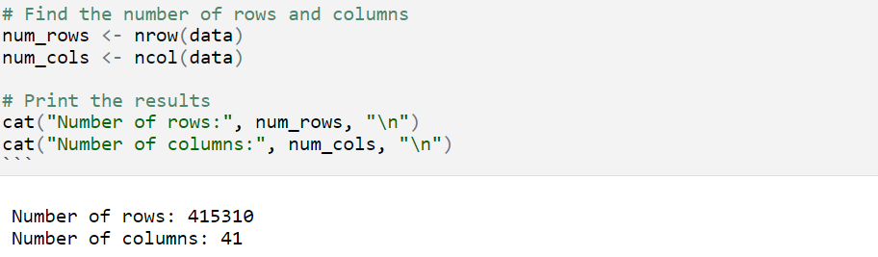
Data import
Since data is imported directly from the URL, the models will always show relevancy with time.

Slide 5
New York City Crime Report Analysis data cleaning
Removed unwanted columns from the data frame
Checked null values and replaced them
Changed variables to appropriate datatype and filter records for 2023
Removed timestamps from date column
Removed minutes and hours from time column to use it in visualization
Replaced null values under ‘suspect gender’ with Unknown
Rename the columns
Transform Age group of the suspect and the victim into correct age group label

Slide 6
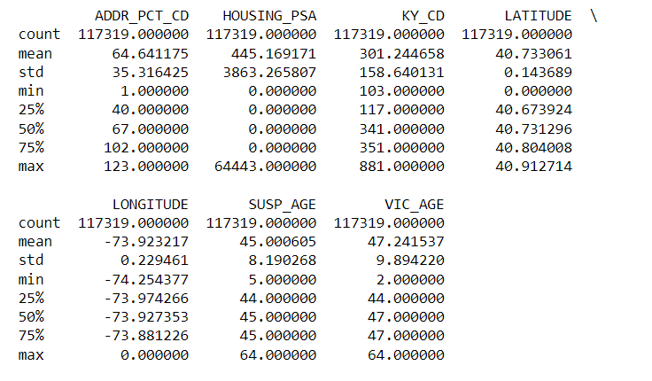
New York City Crime Report Analysis Descriptive Analysis
The average age of suspects is 45 years
The average age of victims is approximately 47 years

Slide 7
Data Visualization

Slide 8
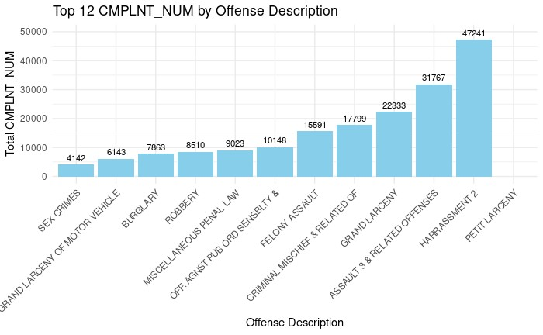
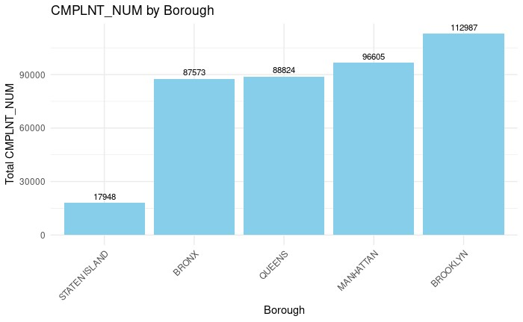
New York City Crime Report Analysis What are the top 12 offenses reported in NewY ork city in 2023?
Petit larceny and Harassment are the most common crimes in the city with about 47,241 and 31,767 cases, respectively.
Sex Crimes are least likely to occur.

Slide 9
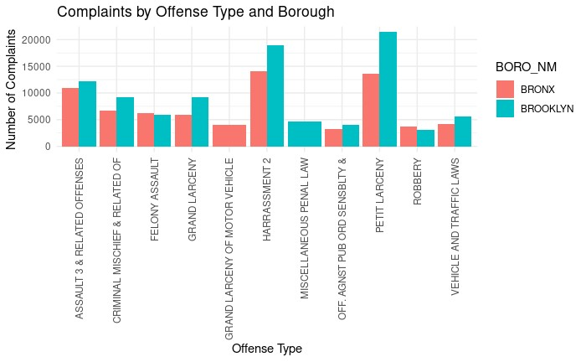
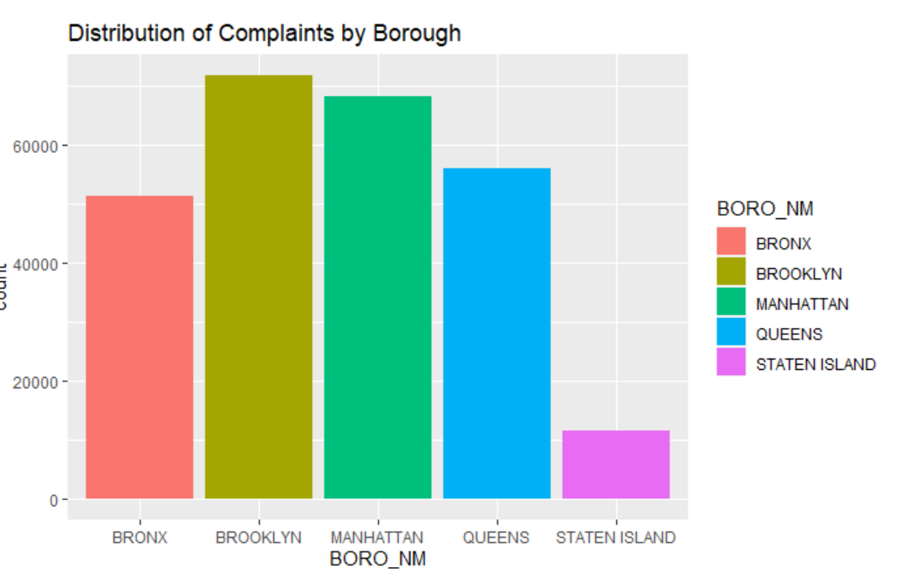
New York City Crime Report Analysis How are frequencies of the Offense crimes within the 2 patrols with highest crimes Bronx and Brooklyn
The crime incidents are most common in the patrol borough of the Brooklyn.

Slide 10
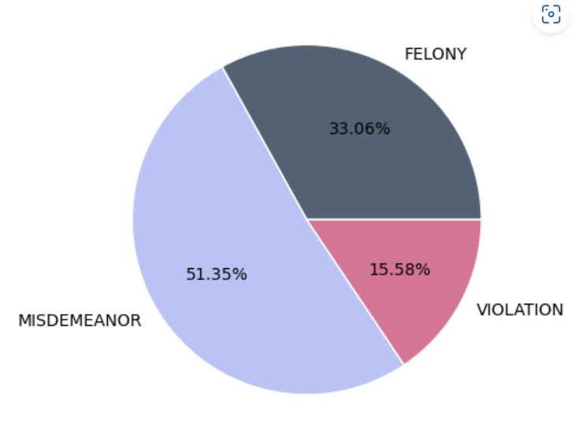
New York City Crime Report Analysis What is the proportion of each law category for the crimes being reported?
More than 51.35% of crimes are Misdemeanors, while 33.06% are cases of Felony

Slide 11
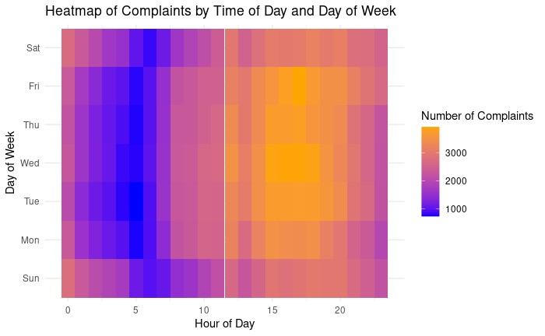
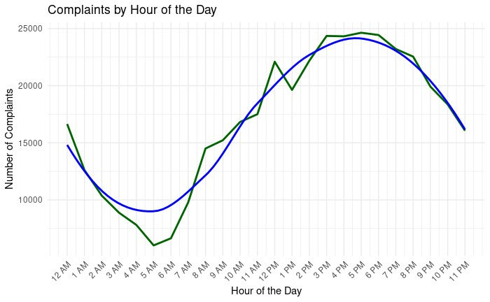
New York City Crime Report Analysis On what days and times is it most likely for a crime to occur in New York City?
The crimes in the city are most likely to occur on a weekday between noon to 6 pm.

Slide 12
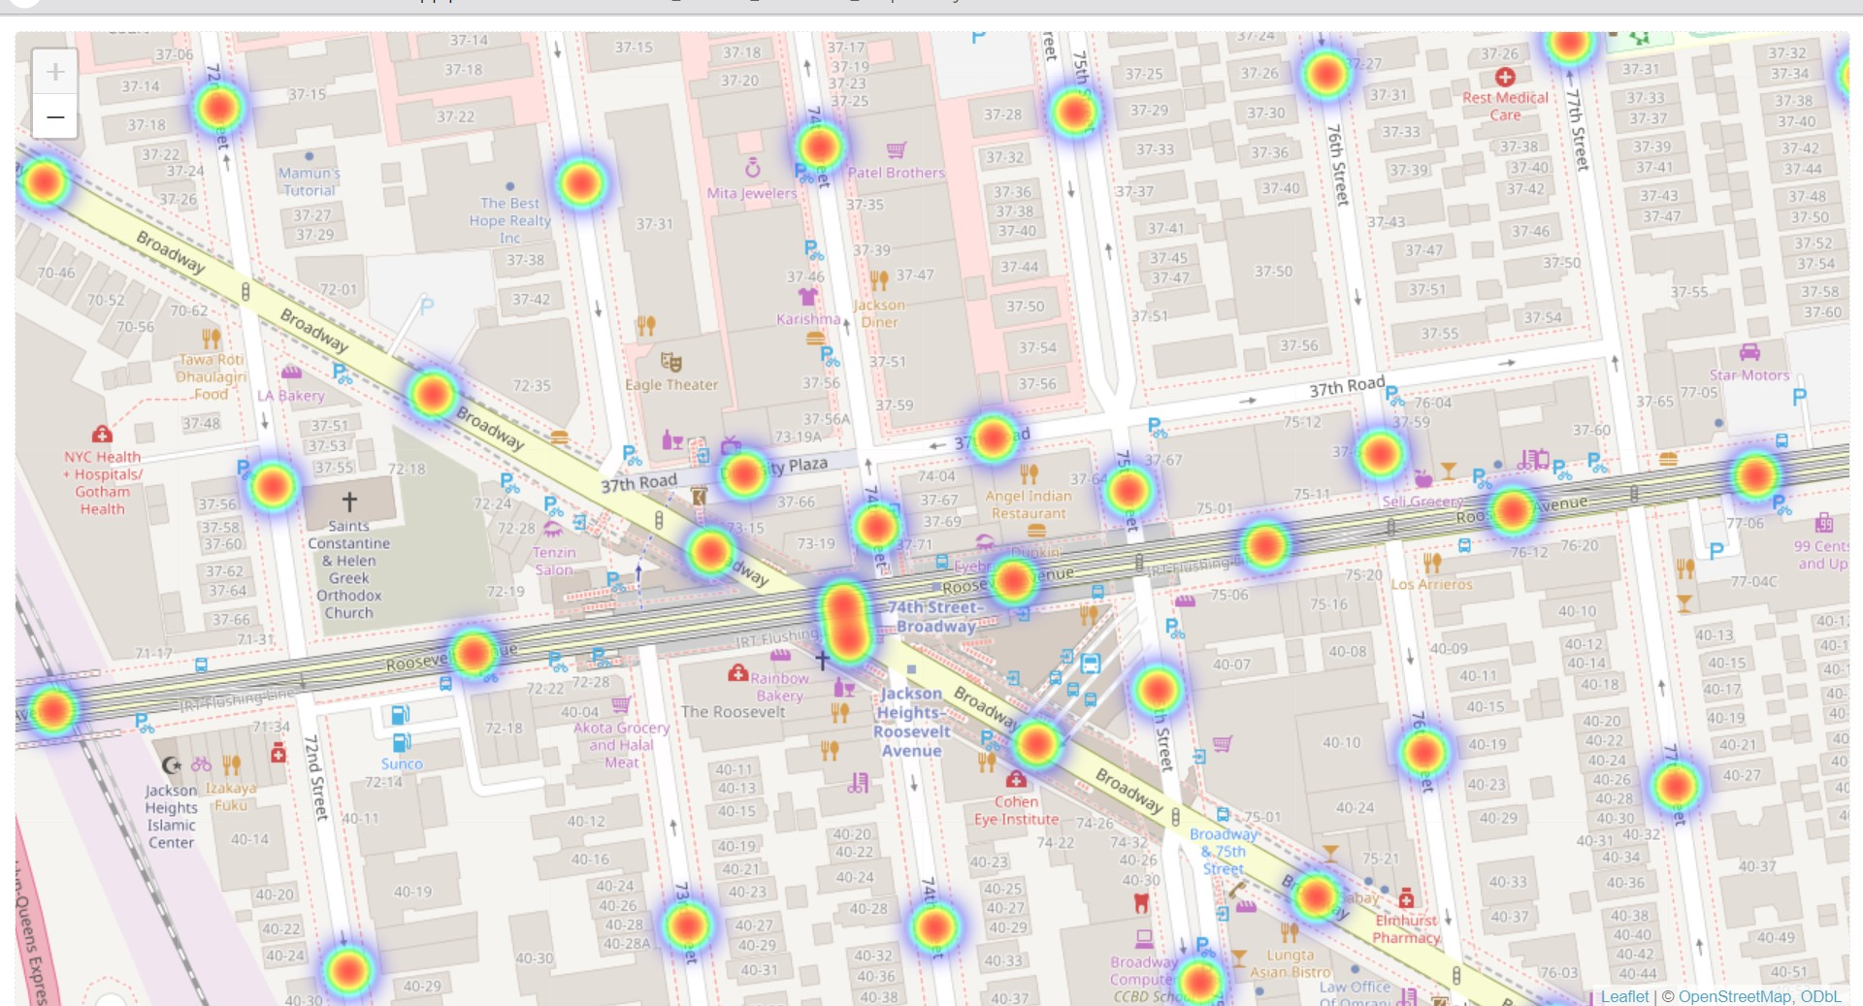
New York City Crime Report Analysis Which have been the most unsafe locations in 2023 within the city of New York?
Orange regions are the most unsafe while Purple regions are the safest.
Bronx, Queens, Manhattan, and Brooklyn are the areas with the most number of reported cases.

Slide 13
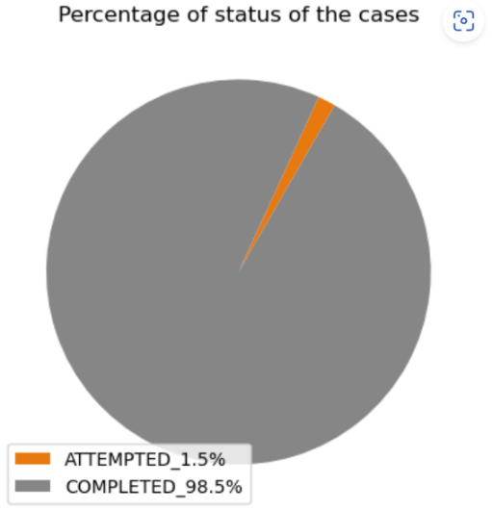
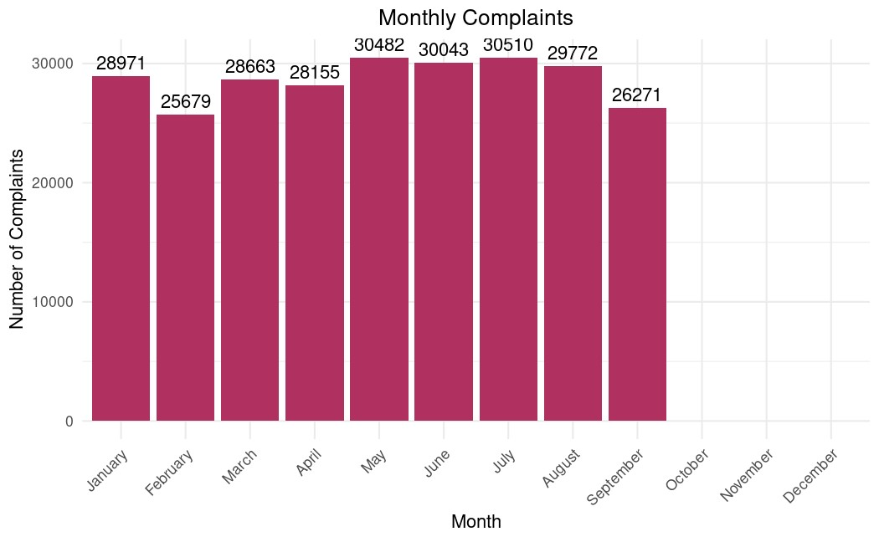
New York City Crime Report Analysis What proportion of crimes has been solved by now and how many crimes are monthly reported?
More than 98.5 percent of the cases are Completed by the NYPD.

Slide 14
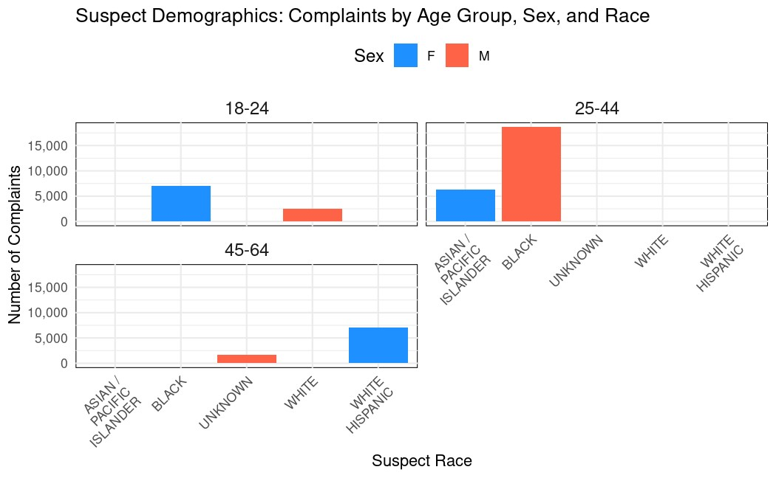
New York City Crime Report Analysis Which race do the suspects belong to the most?
Mostly the race of the suspects are unknown in the reports.
There are greater number of suspects from the Black Community in the city. Followed by White Hispanics. The age group of most suspects were unknown yet evidently most of them were Adults.
.

Slide 15
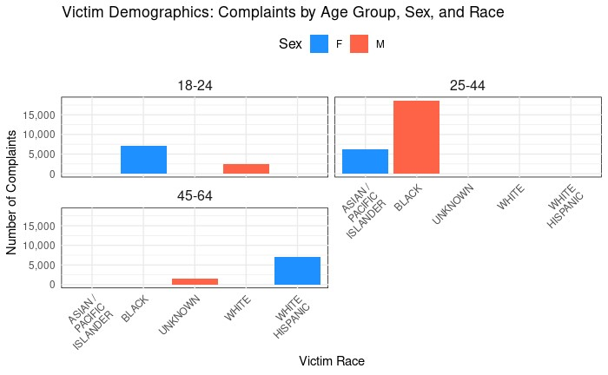
New York City Crime Report Analysis Which race do the victim belong to the most?
The age group of most suspects were unknown yet evidently most of them were Adults.

Slide 16
Prediction Models

Slide 17
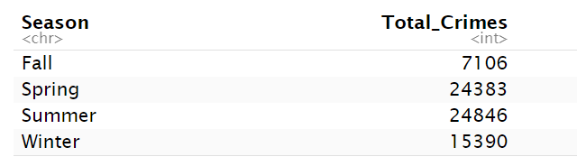
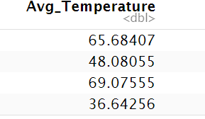
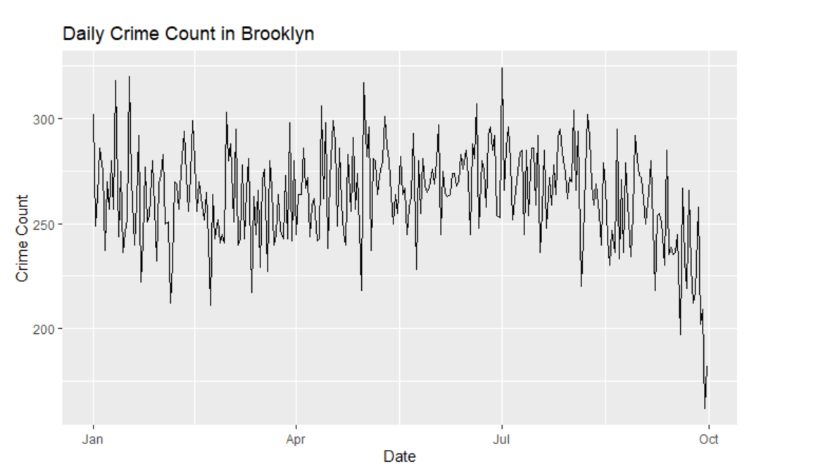
New York City Crime Report Analysis by Weather linear regression analysis During which season is the highest crime?

Slide 18
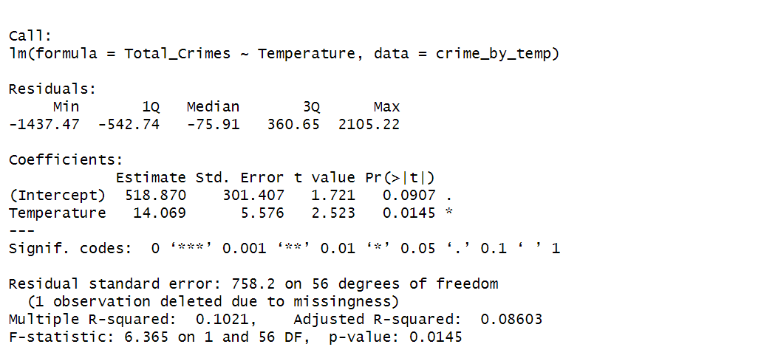
New York City Crime Report Analysis by Weather linear regression analysis Do Temperature cause surge in crimes?
The change in Total_Crimes for a one-unit change in Temperature

Slide 19
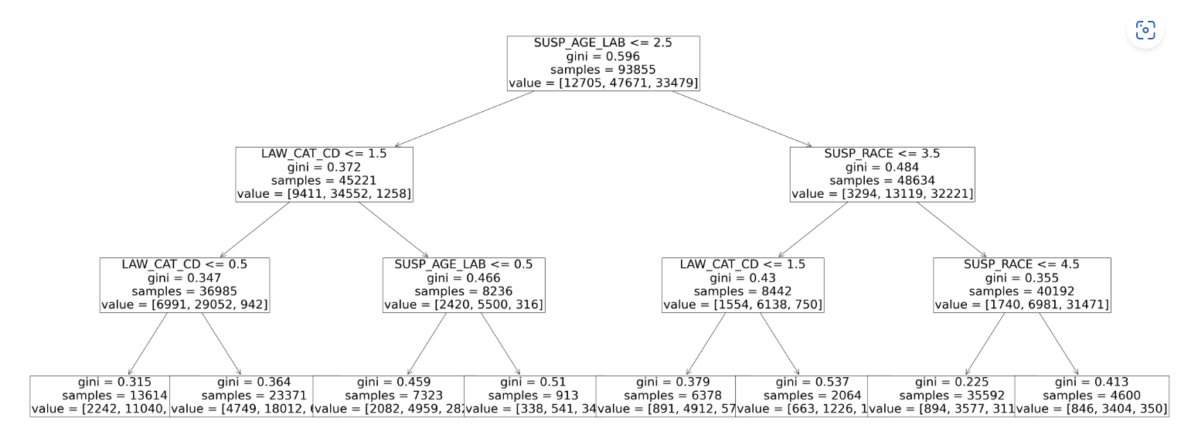
New York City Crime Report Analysis The Decision Tree model: Predicting suspect gender

Slide 20
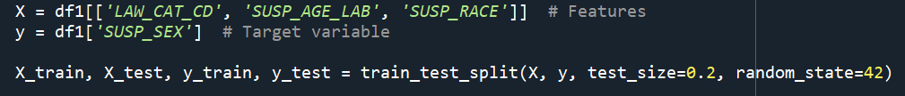
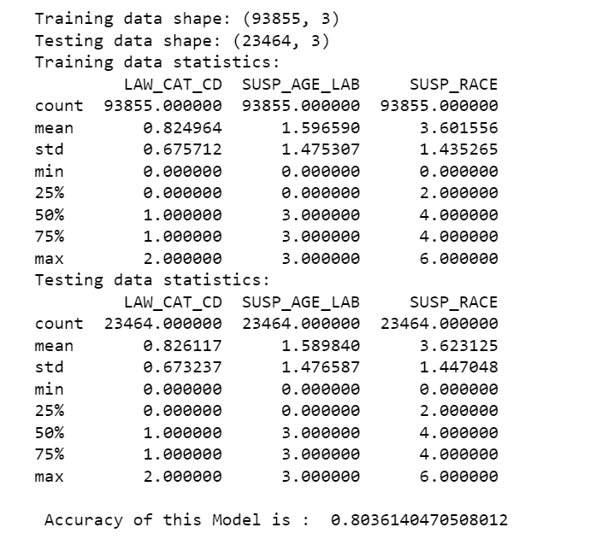
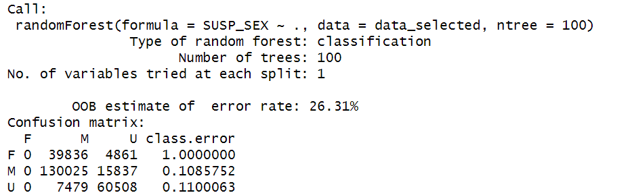

New York City Crime Report Analysis The Decision Tree model: Accuracy level
Accuracy Rate≈0.7369

Slide 21
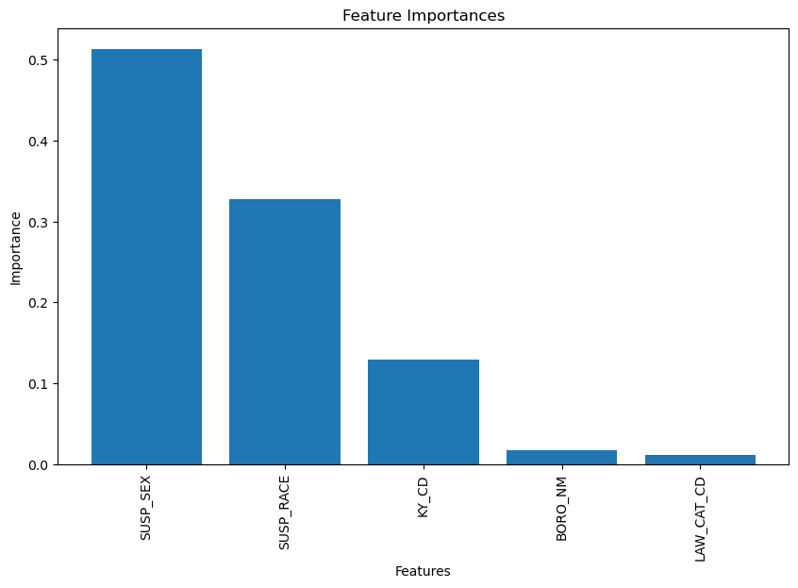
New York City Crime Report Analysis Random forest model: Feature selection

Slide 22
conclusion
Most of the suspects and the victims are middle-aged adults involved in crime incidents around New Yor City.
Most crimes occur in Brooklyn and the patrol borough of the Manhattan.
Most crime incidents occur inside the police precincts.
Most of the suspects are adults from the ‘black’ and ‘white Hispanic’ race.
Most crimes are either Petit larceny or Harassment and more than 50% of the crimes fall under the law category of ‘Misdemeanor’.
98.5% of the reported cases are closed by the NYPD.
Crime reports took a dip in February across the 5 boroughs within NYC.
Most crimes are reported on weekdays between noon to 6 pm.
There is no significant correlation between the variables, however, one can predict if weather conditions can surge in crime rates.
The random forest model gives us ‘suspect sex’ and ‘suspect race’ as the two most influential features in predicting the age group of the suspect, with 73% accuracy.

Slide 23
Thank you!

